Slide 1
ContainerOps
Meaglith Ma <genedna@outlook.com>

Slide 2

Who am I?
马全一
Meaglith Ma <genedna@outlook.com>
微博：@马全一
Twitter：@genedna
Github：https://github.com/genedna

Slide 3

Dxxkor – “He Who Must Not Be Named”

Slide 4
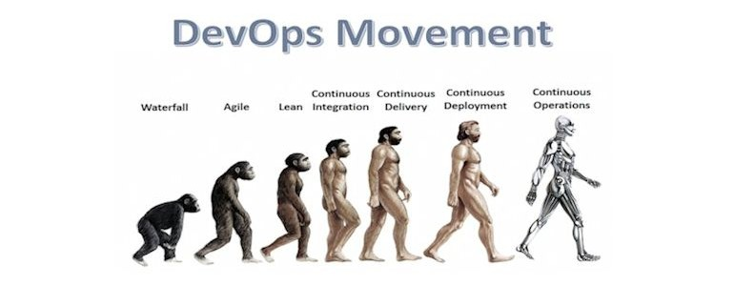
DevOps Next Movement - ContainerOps

Slide 5

DevOps Cycle Is Too Heavy

Slide 6

Container Will Be The Core Of DevOps Cycle

Slide 7

Don’t Break DevOps – Redefine With Container

Slide 8
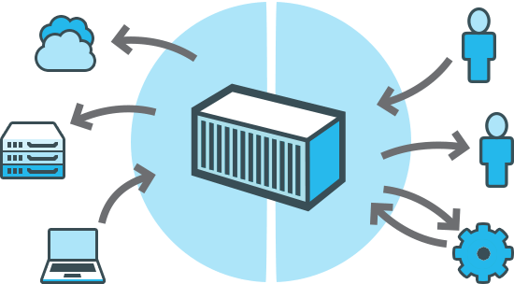
What’s Dxxkor ?
Dxxker Engine
A portable, lightweight application runtime and packaging tool
Dxxker Hub
A cloud service for sharing applications and automating workflows

Slide 9

Container War In 2016 - Dxxkor VS Rocket

Slide 10
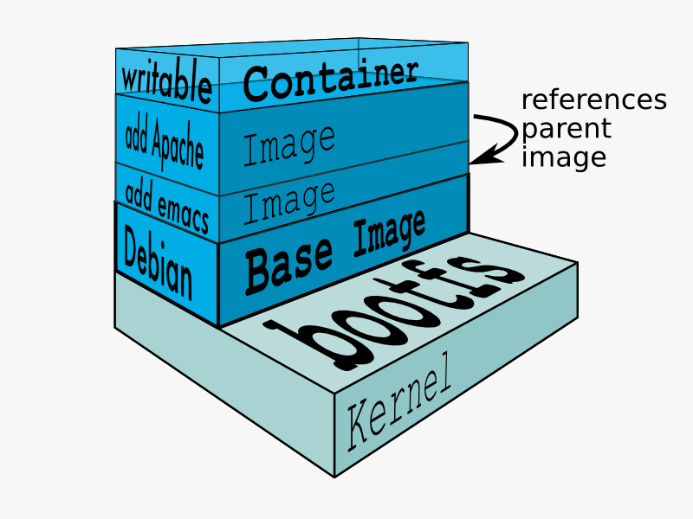
Application Version Challenge – Union File System

Slide 11
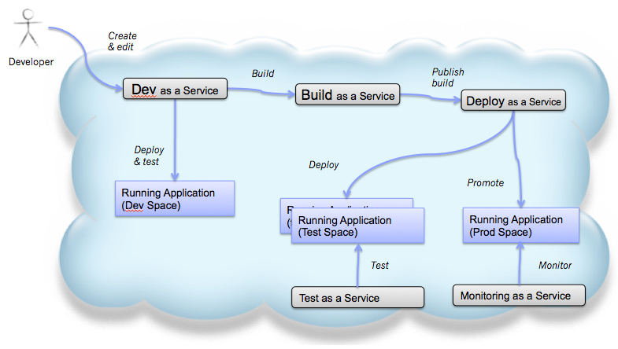
Container & ContainerOps As A Service

Slide 12

First Step – Container Build
Container Build Link Git Service With Image Storage

Slide 13

Container Build With Jenkins

Slide 14
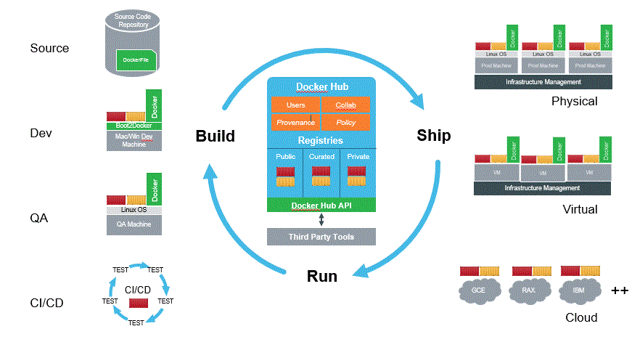
Not Just Build – Everything Within Container

Slide 15

ContainerOps Project Not Born

Slide 16
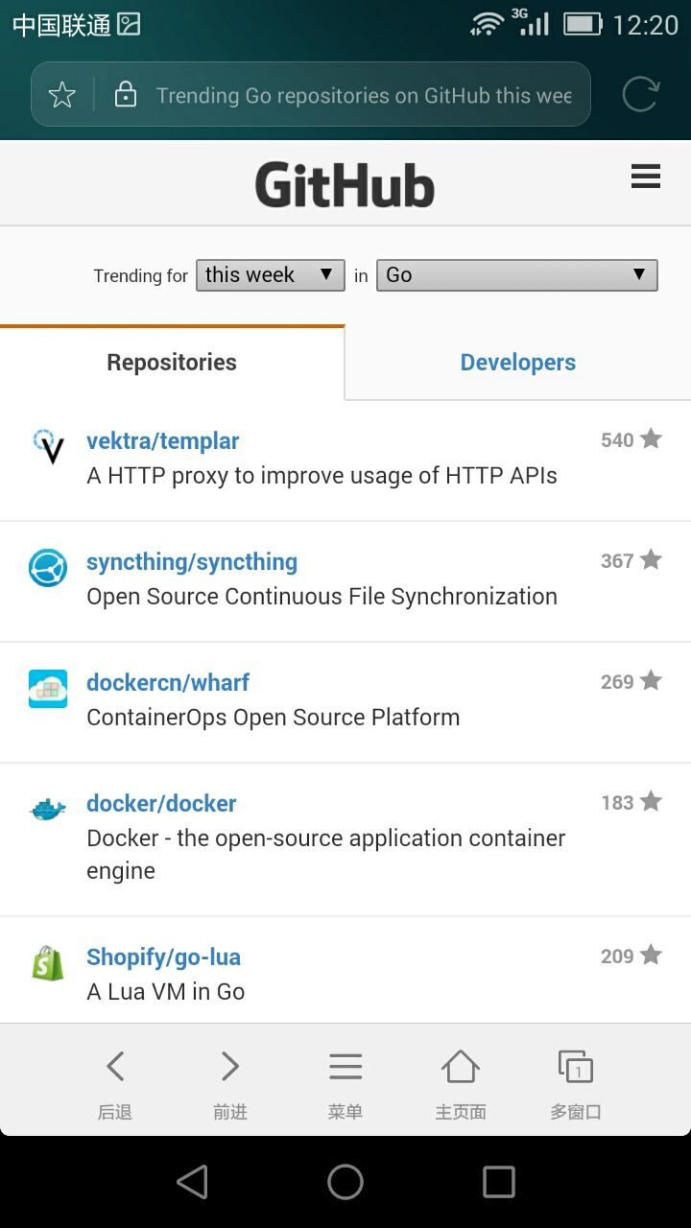
Wharf – Not Just Dxxkor Hub Enterprise Open Source Replace
Support dxxker registry API v1 and v2 at the same time.
Support dxxker registry API V2 manifest convert API V1 JSON format.
https://github.com/dockercn/wharf

Slide 17
Q & A

